Slide 1
Namma Kadai
M.Mohammed Anas
CSE
mohammedanasman123@gmail.com
Karpagam Institute of Technology

Slide 2
Login Page
I have managed a three logins
The Main Branch login Username=“global” ,Password=“g”
Then Namma Kadai admin login Username=“NammaKadai”,password=“admin”
Then the user id based on the database
If we dont have an account,user should register

Slide 3
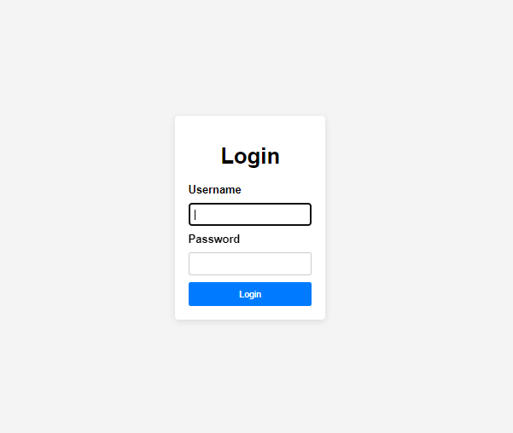
Login Page

Slide 4
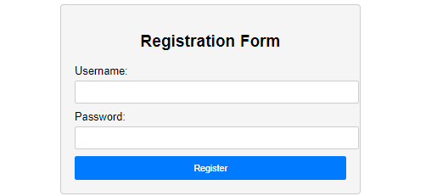
Registration Page

Slide 5
Main Branch
In this main branch,the new product entry and product removal and updations are done in this page
The datas are stored to the items table
It shows the product list from the items table

Slide 6
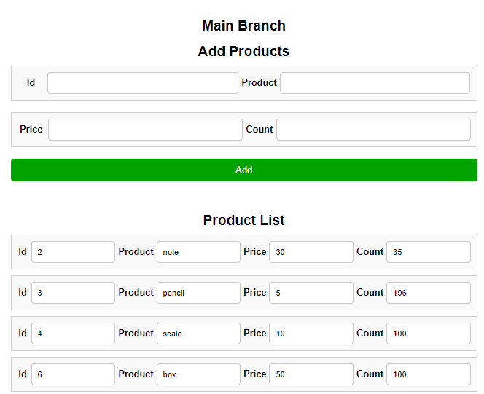
Add and product list

Slide 7
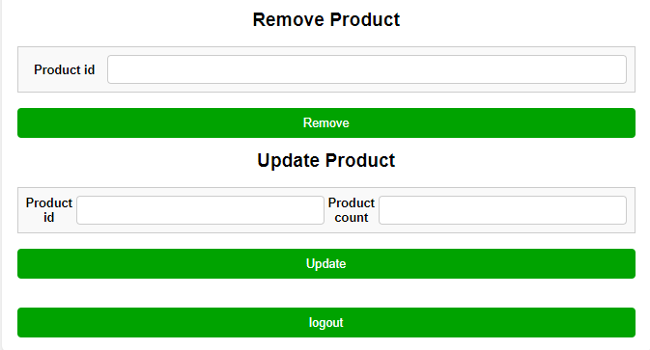
Remove and Update

Slide 8
Namma Kadai Admin Page
In this page we can purchase the products from the main branch list
This page shows the Account balance of the shop
It shows the profit ,which we gain from sell the products
It shows the available products of the main branch and purchased products from the main branch
The purchased products list was maintained in purchase table
It shows the sold list,which was sold to the users.The sold list maintained in the sales table
From this page we can generate a report,we can download that ,the report shows all the details about the sold items,profit,quantity

Slide 9
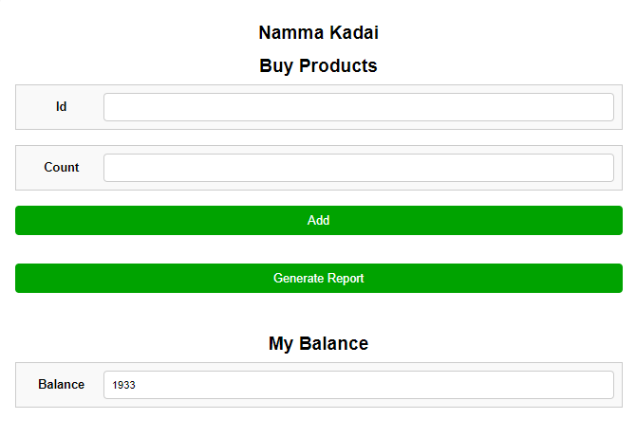
Report generation,buy products and balance

Slide 10
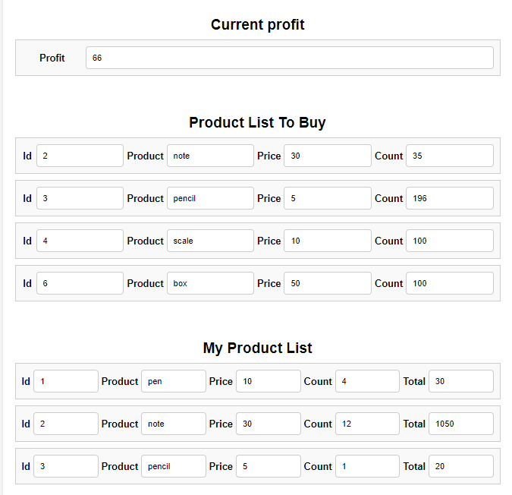
Profit,Item list,purchased list

Slide 11
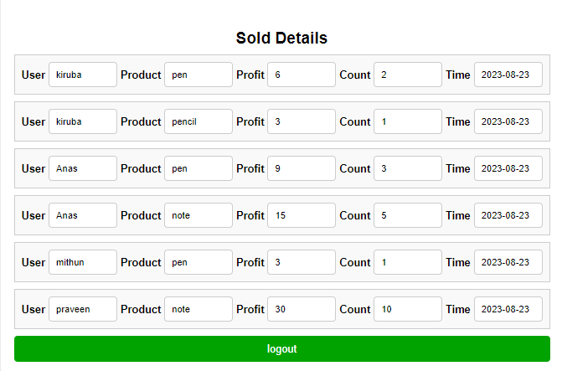
Sold list

Slide 12
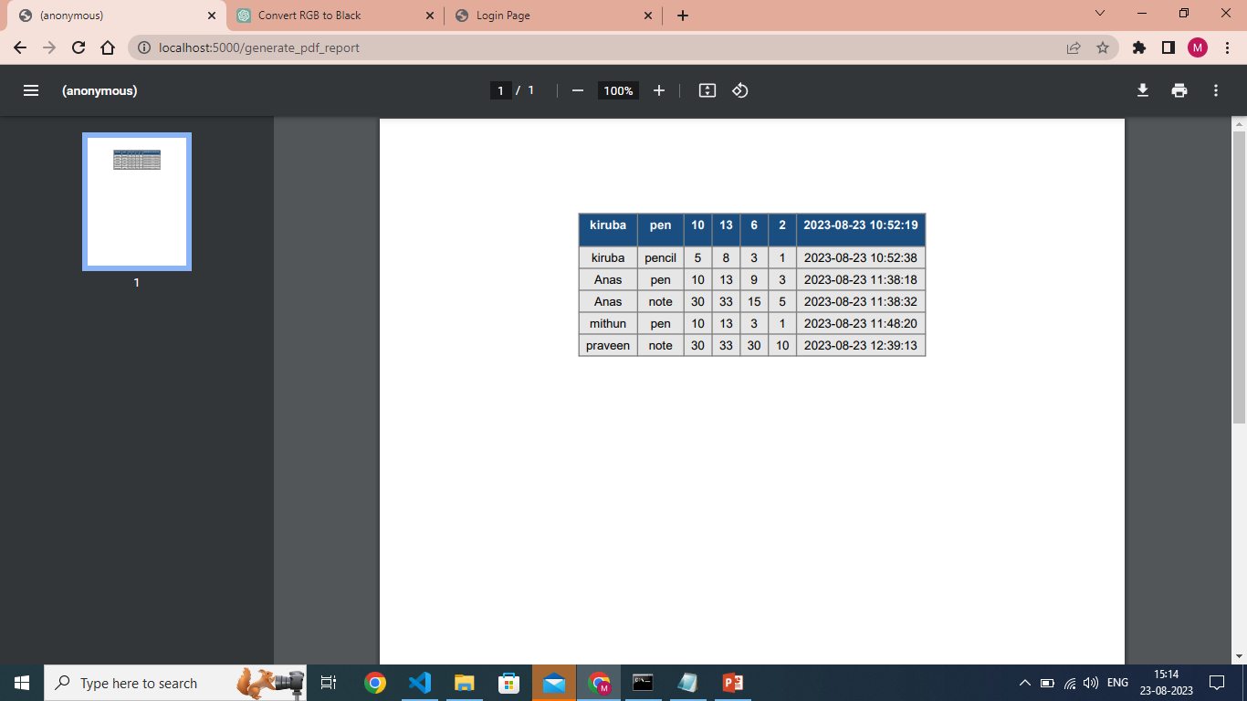
Generated Report

Slide 13
User Page
In the user page, we can purchase the products that are offered by NammaKadai store.
It shows the data temporarily , which was we purchased now.
But the puchased details stored in a sales table with the username

Slide 14
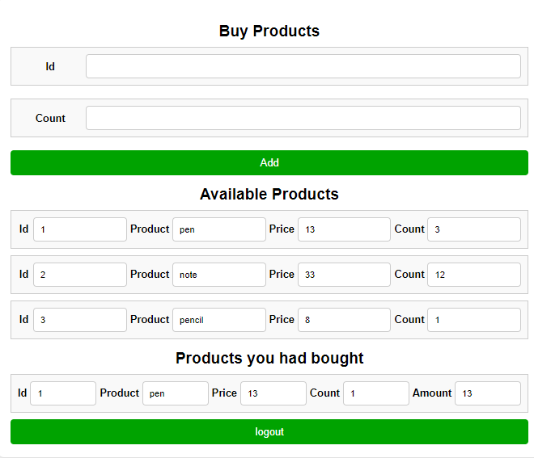
Purchase products,Available list and purchased list

Slide 15


